Slide 1
Who Is
Responsible for
Third-Party Risk Management?

Slide 2
Third-party risk management in practice can be a complex ecosystem of processes, tasks, timing and risk mitigation. Effective third-party risk management ensures that various responsibilities and requirements are distributed across a range of accountable stakeholders, each with a specific job to do.
Charts can help more easily sort it all out to show who does what at a high level. We’ve created some templated options that you can tweak to customize it to how your organization operates. When you’re done editing, print it out or save to refer to as needed throughout your day-to-day work.

Slide 3
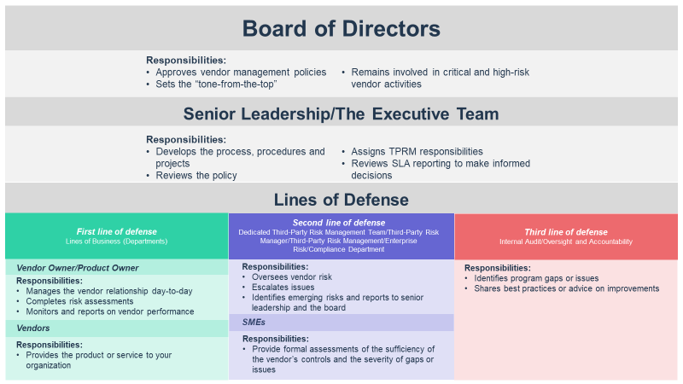
Instructions:
The chart template on the next slide displays the board of directors, senior leadership/executive team and the roles that fall under each line of defense for an overall view of the important roles.
Add, remove or rearrange as it relates to your organization.
We’ve provided a snippet of responsibilities you can include for easy reference as well.
Refer to your organization’s policy and/or the supporting eBook for more responsibilities that may be required, or edits needed, to make this chart customized to your organization.
When you’re done editing, print it out or save it to your files!

Slide 4
Board of Directors
Responsibilities:
Approves vendor management policies
Sets the “tone-from-the-top”
Remains involved in critical and high-risk vendor activities
Senior Leadership/The Executive Team
Responsibilities:
Develops the process, procedures and projects
Reviews the policy
Assigns TPRM responsibilities
Reviews SLA reporting to make informed decisions
Lines of Defense
Second line of defense
Dedicated Third-Party Risk Management Team/Third-Party Risk Manager/Third-Party Risk Management/Enterprise Risk/Compliance Department
First line of defense
Lines of Business (Departments)
Third line of defense
Internal Audit/Oversight and Accountability
Vendor Owner/Product Owner
Responsibilities:
Oversees vendor risk
Escalates issues
Identifies emerging risks and reports to senior leadership and the board
Responsibilities:
Identifies program gaps or issues
Shares best practices or advice on improvements
Responsibilities:
Manages the vendor relationship day-to-day
Completes risk assessments
Monitors and reports on vendor performance
Vendors
SMEs
Responsibilities:
Provides the product or service to your organization
Responsibilities:
Provide formal assessments of the sufficiency of the vendor’s controls and the severity of gaps or issues

Slide 5
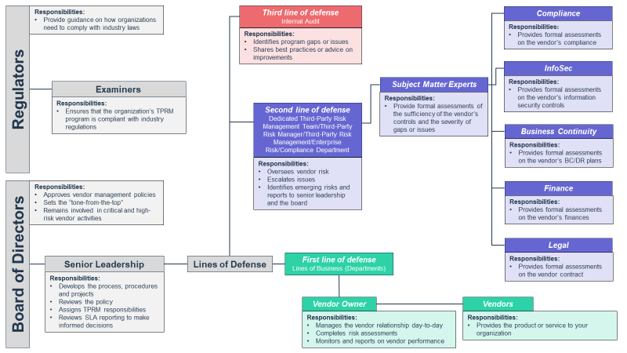
Instructions:
The chart template on the next slide displays the board of directors, regulators/examiners, senior leadership/executive team and the roles that fall under each line of defense. This is a more detailed view of your organizational structure as it relates to TPRM, designed left to right.
Add, remove or rearrange as it relates to your organization.
We’ve provided a snippet of responsibilities you can include for easy reference as well.
Refer to your organization’s policy and/or the supporting eBook for more responsibilities that may be required, or edits needed, to make this chart customized to your organization.
When you’re done editing, print it out or save it to your files!

Slide 6
Responsibilities:
Provide guidance on how organizations need to comply with industry laws
Third line of defense
Internal Audit
Compliance
Responsibilities:
Identifies program gaps or issues
Shares best practices or advice on improvements
Responsibilities:
Provides formal assessments on the vendor’s compliance
InfoSec
Regulators
Examiners
Subject Matter Experts
Responsibilities:
Provides formal assessments on the vendor’s information security controls
Responsibilities:
Ensures that the organization’s TPRM program is compliant with industry regulations
Responsibilities:
Provide formal assessments of the sufficiency of the vendor’s controls and the severity of gaps or issues
Second line of defense
Dedicated Third-Party Risk Management Team/Third-Party Risk Manager/Third-Party Risk Management/Enterprise Risk/Compliance Department
Business Continuity
Responsibilities:
Provides formal assessments on the vendor’s BC/DR plans
Responsibilities:
Oversees vendor risk
Escalates issues
Identifies emerging risks and reports to senior leadership and the board
Responsibilities:
Approves vendor management policies
Sets the “tone-from-the-top”
Remains involved in critical and high-risk vendor activities
Finance
Responsibilities:
Provides formal assessments on the vendor’s finances
Legal
Board of Directors
Senior Leadership
Lines of Defense
First line of defense
Lines of Business (Departments)
Responsibilities:
Provides formal assessments on the vendor contract
Responsibilities:
Develops the process, procedures and projects
Reviews the policy
Assigns TPRM responsibilities
Reviews SLA reporting to make informed decisions
Vendor Owner
Vendors
Responsibilities:
Manages the vendor relationship day-to-day
Completes risk assessments
Monitors and reports on vendor performance
Responsibilities:
Provides the product or service to your organization

Slide 7
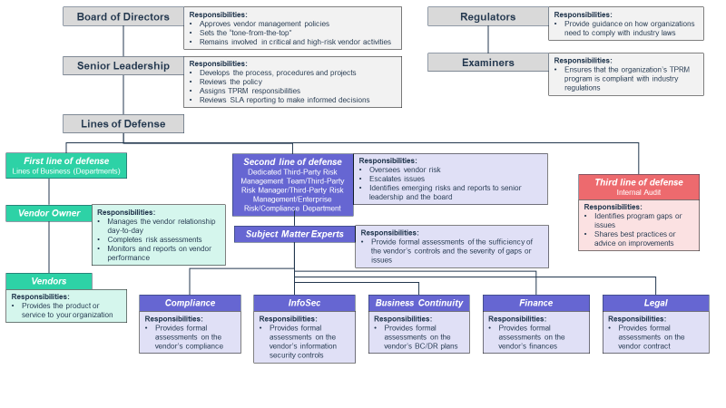
Instructions:
The chart template on the next slide displays the board of directors, regulators/examiners, senior leadership/executive team and the roles that fall under each line of defense. This is a more detailed view of your organizational structure as it relates to TPRM, designed top to bottom.
Add, remove or rearrange as it relates to your organization.
We’ve provided a snippet of responsibilities you can include for easy reference as well.
Refer to your organization’s policy and/or the supporting eBook for more responsibilities that may be required, or edits needed, to make this chart customized to your organization.
When you’re done editing, print it out or save it to your files!

Slide 8
Board of Directors
Responsibilities:
Approves vendor management policies
Sets the “tone-from-the-top”
Remains involved in critical and high-risk vendor activities
Regulators
Responsibilities:
Provide guidance on how organizations need to comply with industry laws
Senior Leadership
Responsibilities:
Develops the process, procedures and projects
Reviews the policy
Assigns TPRM responsibilities
Reviews SLA reporting to make informed decisions
Examiners
Responsibilities:
Ensures that the organization’s TPRM program is compliant with industry regulations
Lines of Defense
First line of defense
Lines of Business (Departments)
Second line of defense
Dedicated Third-Party Risk Management Team/Third-Party Risk Manager/Third-Party Risk Management/Enterprise Risk/Compliance Department
Responsibilities:
Oversees vendor risk
Escalates issues
Identifies emerging risks and reports to senior leadership and the board
Third line of defense
Internal Audit
Vendor Owner
Responsibilities:
Manages the vendor relationship day-to-day
Completes risk assessments
Monitors and reports on vendor performance
Responsibilities:
Identifies program gaps or issues
Shares best practices or advice on improvements
Subject Matter Experts
Responsibilities:
Provide formal assessments of the sufficiency of the vendor’s controls and the severity of gaps or issues
Vendors
Responsibilities:
Provides the product or service to your organization
Compliance
InfoSec
Business Continuity
Finance
Legal
Responsibilities:
Provides formal assessments on the vendor’s compliance
Responsibilities:
Provides formal assessments on the vendor’s information security controls
Responsibilities:
Provides formal assessments on the vendor’s BC/DR plans
Responsibilities:
Provides formal assessments on the vendor’s finances
Responsibilities:
Provides formal assessments on the vendor contract

